Slide 1



AWS Foundation
Storage – Simple Storage Service (S3)
Copyright IntelliPaat, All rights reserved

Slide 2
Agenda
9
Demo
17
Cross-Region Replication
1
Pre-S3: Online Cloud Storage
10
Objects
18
Data Encryption
2
Pre-S3: API
11
Metadata & Storage Class
Server Access Logging
3
S3 Introduction
19
4
12
Versioning
20
Demo
S3 Consistency Models
13
Demo
21
Connect using VPC endpoint
5
Examples
20
14
Lifecycle Management
22
S3 Pricing
6
Demo
15
Storage Class Analysis
23
Quiz
7
Storage Hierarchy
8
Buckets
16
Demo

Slide 3
Pre-S3: Online Cloud Storage

Slide 4





Online Cloud Storage
Upload files, folders, images, songs, videos from a machine and access it from anywhere in the world.
Dropbox
iCloud
OneDrive
Google Drive

Slide 5
Pre-S3: API

Slide 6




Application Programming Interface (API)
What is API?
An API is a list of specifications which describes how information is exchanged between programs.
Software that wants to access another will call the API published by the other program.
Java, .NET, python
Developer

Slide 7
S3 Introduction

Slide 8







S3 Concepts
Simple Storage Service
Amazon Simple Service (S3) is a storage that can be maintained and accessed over the Internet.
S3 provides web service which can be used to store and retrieve unlimited amount of data. Same can be done programmatically using Amazon provided APIs.

Slide 9
S3 Consistency Models

Slide 10


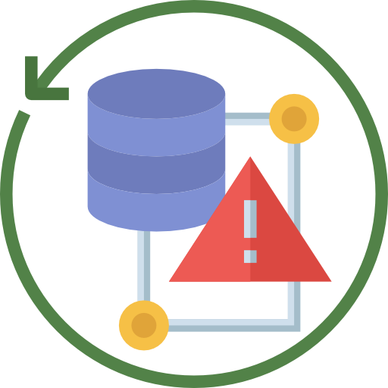


S3 Data Consistency Model
S3 provides highly durable and available solution by replicating all data in multiple data centers in a region.
Data uploaded in a particular region never leaves it.
Read-after-write consistency.
Eventual consistency.
Replication of Data in multiple Data Centers
Data uploaded never leaves the data center
Read after write
Eventual consistency

Slide 11
S3 Data Consistency Model
Consistent Read | Eventual Consistent Read
No stale reads | Stale reads are POSSIBLE
Higher comparative read latency | Lower comparative read latency
Read throughput is comparatively lower | Read throughput is highest
Replication of Data in multiple Data Centers
Data uploaded never leaves the data center
Read after write consistency
Eventual consistency

Slide 12




Consistency Models
EVENTUAL consistency: For UPDATES and DELETES.
Region
S3

Slide 13
Consistency Models
EVENTUAL consistency: For UPDATES and DELETES.
Region
S3

Slide 14
Consistency Models
EVENTUAL consistency: For UPDATES and DELETES.
Region
S3

Slide 15
Examples

Slide 16
Consistency Examples
Example 1
Concurrent applications
W1 → Name: “EC2”, W2 → Name: “EBS”
R1 → consistent – Name: “EBS”, eventual – Name: “EBS” or “EC2” or Nothing.
R2 → consistent – Name: “EBS”, eventual – Name: “EBS” or “EC2” or Nothing.
W1
R1
Application 1
Application 2
W2
R2

Slide 17
Consistency Examples
Example 2
Concurrent applications
W1 → Name: “EC2”, W2 → Name: “EBS”
R1 → consistent – Name: “EBS” or “EC2”, eventual – Name: “EBS” or “EC2” or Nothing.
R2 → consistent – Name: “EBS”, eventual – Name: “EBS” or “EC2” or Nothing.
W1
R1
Application 1
Application 2
W2
R2

Slide 18
Demo

Slide 19
Demo 1: Upload Files in S3
Let’s upload a few image and text files in S3.
How to access those files.

Slide 20
Storage Hierarchy

Slide 21



Storage Hierarchy
S3
S3 follows a storage hierarchy in keeping data (documents, images, videos, files etc.).
Management console or S3 APIs can be used to manage buckets and objects.
Buckets
Objects
Buckets with objects

Slide 22
Buckets

Slide 23



Buckets
By default, the maximum number of buckets that can be created per account is 100. For additional buckets, one can submit a service limit increase.
Bucket count & restrictions
Communicating using SDK
Accessing Buckets
Naming Convention
1
2
100

Slide 24
Buckets
While using AWS SDKs, the client is created and then this client is used to send request to create bucket. The client is created by specifying an AWS region and then client uses endpoint to communicate with Amazon S3 .
Bucket count & restrictions
Communicating using SDK
For Example:
Accessing Buckets
If client is created by specifying the N. Virginia (Default region), then following endpoint is used to communicate Amazon S3:
Naming Convention
s3.amazonaws.com
For any other Region:
– s3<region>.amazonaws.com

Slide 25



Buckets
Types of URL to access buckets
Virtual hosted style: http://bucket.s3.amazonaws.com/object OR http://bucket.s3-aws-region.amazonaws.com/object
Path style: http://s3.amazonaws.com/bucket/object OR http://s3-aws-region.amazonaws.com/bucket/object
Bucket count & restrictions
Communicating using SDK
Accessing Buckets
Naming Convention

Slide 26


Buckets
Bucket names have to be Globally unique irrespective of which region they are created in. As bucket can be accessed using URLs, it is recommended that bucket names follow DNS naming conventions, all letters should be in small.
Bucket count & restrictions
Communicating using SDK
Accessing Buckets
Naming Convention
DNS Naming

Slide 27
Objects

Slide 28

Objects
When there is no folder and object resides in the bucket
Objects are videos, images, documents etc. which are stored inside of buckets.
While creating a bucket a name is given, “name” is the object key.
There cannot be any sub-bucket or sub-folder inside of a bucket (physically, however folders can be created on the console which provides a logical hierarchy only, which are used as prefixes in the object key.)
my-s3-bucket
myobject
http://my-s3-bucket.s3.amazonaws.com/myobject
When there is a folder on console, folder name is used as prefix with object key.
my-s3-bucket
myfolder
myobject
http://my-s3-bucket.s3.amazonaws.com/myfolder/myobject

Slide 29
Metadata & Storage Class

Slide 30
Metadata & Storage Class
Object metadata – for each object S3 maintains a set of system metadata.
Date: Current date and time.
Content-length: Object size in bytes.
Last-modified: Object creation or last modified date.
x-amz-server-side-encryption: whether encryption is enabled or not.
x-amz-version-id: object version.
x-amz-delete-marker: Whether the object is a delete marker in case of versioning.
x-storage-class: Storage class associated with the object.
Storage Class – each object has a storage class associated with it.
STANDARD: For frequently accessed data. 11 9s of durability, 4 9s of availability.
STANDARD IA: For less frequently real-time accessed data. 11 9s of durability, 3 9s of availability.
REDUCED REDUNDANCY: For non-critical, reproducible data with lower levels of redundancy than Standard storage class. 4 9s of durability and 4 9s of availability.

Slide 31
Versioning

Slide 32
Versioning
Versioning enables to keep multiple versions of the same object in one bucket.
Versioning has to be enabled explicitly. Each object has a version ID.
Existing objects are not overwritten.
GET my-object
GET my-object, v1.1
Not Found
DEL Marker on v1.2
DELETE my-object
v1.2
v1.2
PUT/INSERT my-object
v1.1
v1.1
PUT/INSERT my-object
v1.0
v1.0
PUT/INSERT my-object
my-object

Slide 33
Demo

Slide 34
Demo 3: Objects
Upload a few objects in the bucket “aws-foundation-bucket” created earlier.
Set permission to everyone for both buckets and objects.
Check storage class for the object created.
Enable versioning in the bucket.
Add a “application:AWS-3”and “Content-type” metadata in one of the objects.

Slide 35
Lifecycle Management

Slide 36
Lifecycle Management
Lifecycle management works at bucket level, enables to perform an action to objects based on rules.
Actions
Transition – Objects are transitioned from one storage class to another.
STANDARD or REDUCED REDUNDANCY to STANDARD_IA.
STANDARD to GLACIER.
Objects must be stored for at least 30 days in the current storage class before transitioning.
Expiration – Objects are expired and deleted.

Slide 37
Storage Class Analysis

Slide 38
Storage Class Analysis
Provides storage access patterns which can help to decide when data/objects should be transitioned.
Maximum 1000 storage class filtered analysis per bucket.
Analysis patterns
Analyze entire content of a bucket.
Analyze objects grouped by tags or prefixes.
Storage class analysis observes the access patterns of a filtered object data set for 30 days or longer to gather enough information for the analysis, a message is displayed in the Amazon S3 console.
How much of data was retrieved out of total storage.
What percentage of storage was retrieved.
How much of storage is infrequently accessed.
Data can be exported for future analysis.

Slide 39
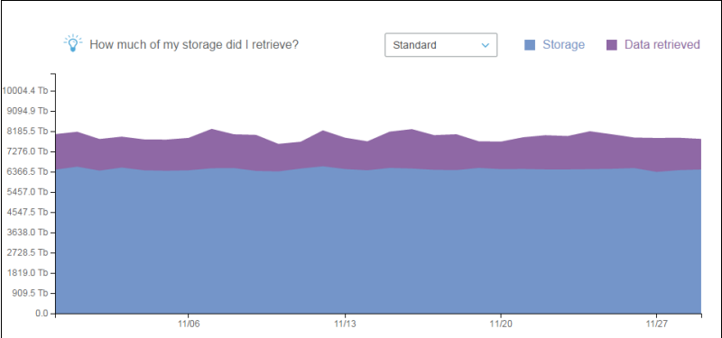
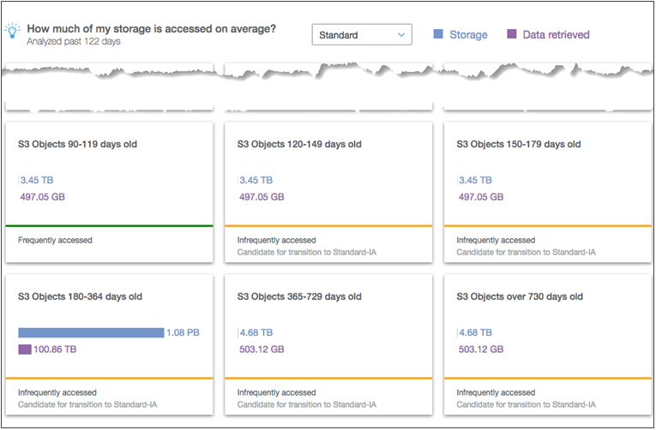
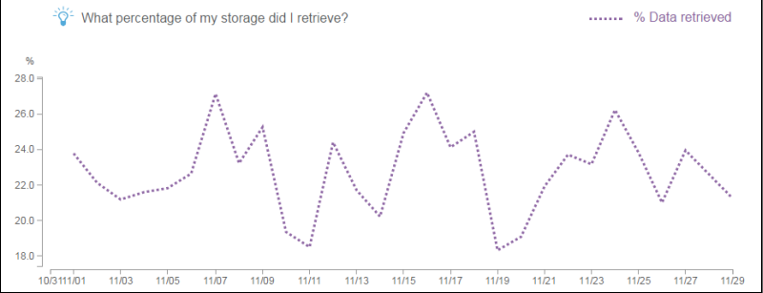
Storage Class Analysis

Slide 40
Inventory
Inventory provides report for Objects and its metadata on a daily or weekly basis in a comma separated output file.
Metadata output is configurable.
Source bucket – Which inventory is created for.
Destination bucket – Where inventory is stored in.

Slide 41
Demo 4: Lifecycle Management
Setup Lifecycle management for only a few objects in a bucket.
Setup Lifecycle management for objects with tag “Training”.

Slide 42
Cross-Region Replication

Slide 43
Cross-Region Replication
Cross-region replication - Automatic asynchronous replication of objects to a different region. Subset of objects can also be replicated using prefix matches.
Versioning should be enabled for CRR to work.
Source bucket or its objects can be replicated to only one target bucket.
Deletion of specific object version is not replicated over to the other region.
Existing objects of a bucket are not replicated (if replication is enabled later on).
Lifecycle management actions are not replicated.
Replicated objects are not replicated to other region.
Mumbai
S3
S3
Oregon
Tokyo

Slide 44



Cross-Region Replication
Compliance Requirements
Latency
Operational
Ownership

Slide 45
Data Encryption

Slide 46

Data Encryption
Encryption can be done for done data in transit and data at rest when.
Server side encryption
S3 encrypts data at the object level as it writes to disks in its data centers and decrypts it when accessed. “x-amz-server-side-encryption-”
SSE-S3 → x-amz-server-side-encryption:AES-256
SSE-KMS → x-amz-server-side-encryption-aws-kms-key-id:<kms_key_id>
SSE-C → customer algorithm, customer key and customer key MD are passed.
Client side encryption
Client-side encryption refers to encrypting data before sending it to Amazon S3. Following two options are available for using data encryption keys
AWS KMS-managed customer master key
client-side master key
XYZ
^#!~ +
ABC
%$#@
Client
AWS Data Center

Slide 47
Server access logging

Slide 48
Server access logging
Access logging enables to track requests at bucket level. Access logs are stored in separate buckets.
Access log format
Bucket owner – Owner of the source bucket.
Bucket name - Name of the bucket that the request was processed against.
Time – Time at which request was received.
Remote IP – IP address of the requestor.
Requester – ID of the requestor.
Operation – REST.http_method.resource_type.
Key – Object key in URL.
Request-URI - Request-URI part of the HTTP request message.
HTTP Status, Error Code & Bytes Sent.
Object Size – Total size of the object in bytes.
Total Time - Measured in ms from the time request is received to the time that the last byte of the response is sent.
Turn-around Time – Number of milliseconds that S3 spent processing the request.
Referrer, User-agent, Version ID.

Slide 49
Demo 6: Website hosting
Create a bucket - <your-name>.s3.static.wesite.bucket (or whatever is suitable for your need).
Upload your HTML page as an object.
Create sub-folder1 in the bucket.
Upload another HTML document in the sub-folder1. Name of this HTML document should be same as that of the one in the bucket
Create sub-folder2 inside sub-folder1 and upload an HTML document with the same name as earlier.
Access the root page and all the subpages using S3 endpoint.
Create one more bucket. Make this bucket to hold all logs for the bucket created in step 1.
Configure redirect so that requests to your main page are redirected to /sub-folder1/sub-folder2.
Integrate S3 website hosting with a custom Domain name using Route53.

Slide 50
Connect using VPC endpoint

Slide 51





Connect using VPC endpoint
Connect to S3 from EC2 instances in Private Subnets, so that traffic never leaves Amazon’s N/W.
Public Subnet
Private Subnet

Slide 52
Connect using VPC endpoint
https://aws.amazon.com/s3/pricing/
Storage
Standard
$0.023/GB for first 50 TB/month
$0.022/GB for next 450 TB/month
$0.021/GB for next 500 TB/month
Standard – IA: $0.0125 per GB
Glacier - $0.004 per GB
Requests
PUT, COPY, POST, LIST - $0.005 per 1000 requests
GET and All Other - $0.0004 per 1000 requests
Total Storage – 750 TB
(50*0.023*1000) + (450*0.022*1000) + (250*0.021*1000) = $16300
150 million GET requests = (150,000,000/1000) * $0.0004 = $6
500,000 PUT requests = (500000/1000) * $0.005 = $2.5

Slide 53
S3 Pricing (us-east-1)

Slide 54
S3 Pricing (us-east-1)
Data Transfer
Data Transfer IN from ANYWHERE is free
Data Transfer OUT to Internet
First 1 GB/month – FREE
Next 10 TB/month - $0.09 per GB
Next 40 TB/month - $0.085 per GB
Next 100 TB/month - $0.07 per GB
More than 150 TB/month - $0.05 per GB
Download per month – 80 TB
(10 * 0.09 * 1000) + (40 * 0.085 * 1000) + (29 * 0.07 * 1000) = $6330

Slide 55
Quiz

Slide 56
Quiz
1. Default limitation of Bucket in each account?
A. 100
B. 200
C. 1000
D. No Limitation

Slide 57
Quiz
2. Objects in the Bucket can be up to what size?
A. 1 TiB
B. 100 TiB
C. 1 GiB
D. 5 TiB

Slide 58
Quiz
3. After enabling Cross Zone replication older data replicated to destination within how much time?
A. 5 mins
B. Depends on Load
C. Older data never gets replicated
D. 1 hour

Slide 59
Quiz
4. How large can a single archive be?
A. 1 TiB
B. 100 TiB
C. 1 GiB
D. 40 TiB

Slide 60

India : +91-7847955955
US : 1-800-216-8930 (TOLL FREE)
sales@intellipaat.com
24X7 Chat with our Course Advisor
Copyright IntelliPaat, All rights reserved
Notes:
Welcome back to the forth module of data science.

